Slide 1




Thermoacoustic Cooling
By: Rylee Palos, Dan Beckstrand, Saumil Nalin
[Team plasma]
Notes:
Hello, we are team plasma, and our project is about thermoacouystic cooling.

Slide 2
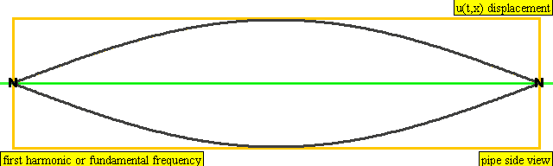
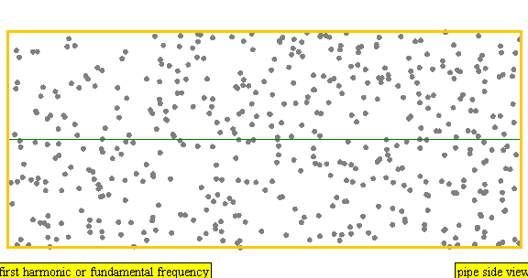
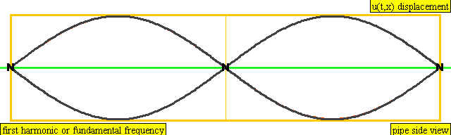
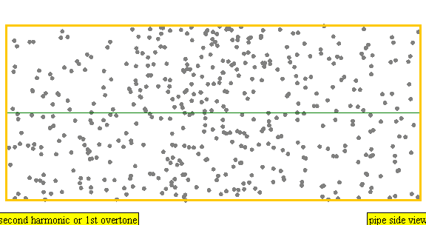
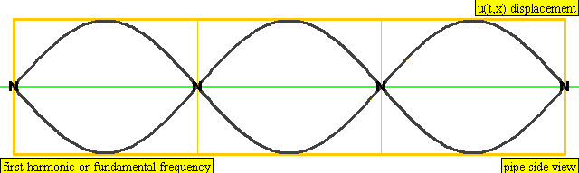
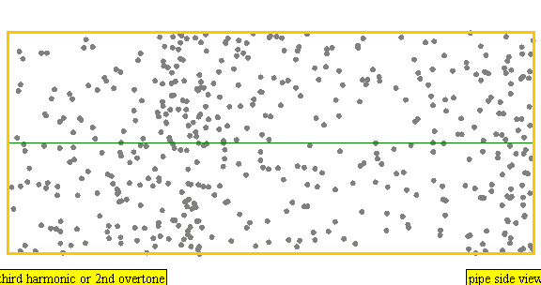

What is The thermoacoustic Effect?
Sound waves: displacement and pressure oscillations
Pressure oscillations cause temperature change
Fundamental & resonant frequencies: standing wave in tube
Nodes = order of harmonic
nth harmonic frequency: $f_{n}=nf_{1}$
Thermoacoustic effect: energy conversion between sound and heat
Thermoacoustic engine: heat converted to sound
Thermoacoustic refrigerator: sound converted to heat
Figure 1.
First, second, and third harmonics, shown in string and molecule representations.
Notes:
What is thermoacoustic effect. As we all know, sound travels in waves. In a medium, like air, this leads to pressure and displacement oscillations. Because of these pressure changes, the temperature of the medium oscillates as well. One way to observe this effect is through tubes. Every tube has a fundamental frequency that depends on the length of the tube. If a speaker plays this frequency, or any of its corresponding harmonics, there will be a standing wave inside the tube. The number of nodes each wave has depends on the order of the harmonic, which is an integer multiple of the first harmonic. This can be seen in the graphics on the right. The string representation of the first, second, and third harmonics are shown on the left side. The corresponding molecule version is shown next to them and more accurately shows what is happening in the medium. The frequency of each harmonic depends on the harmonic number, n. The fundamental frequency depends on the tube length and speed of sound, though the exact number depends on if the tube is closed on both ends or open on one.
The thermoacoustic effect occurs when sound waves and heat work together. If heat is converted into acoustic energy, it is a thermoacoustic engine. If the energy from the sound waves is used to transport heat from low to high temperature sources, it is a thermoacoustic refrigerator.

Slide 3
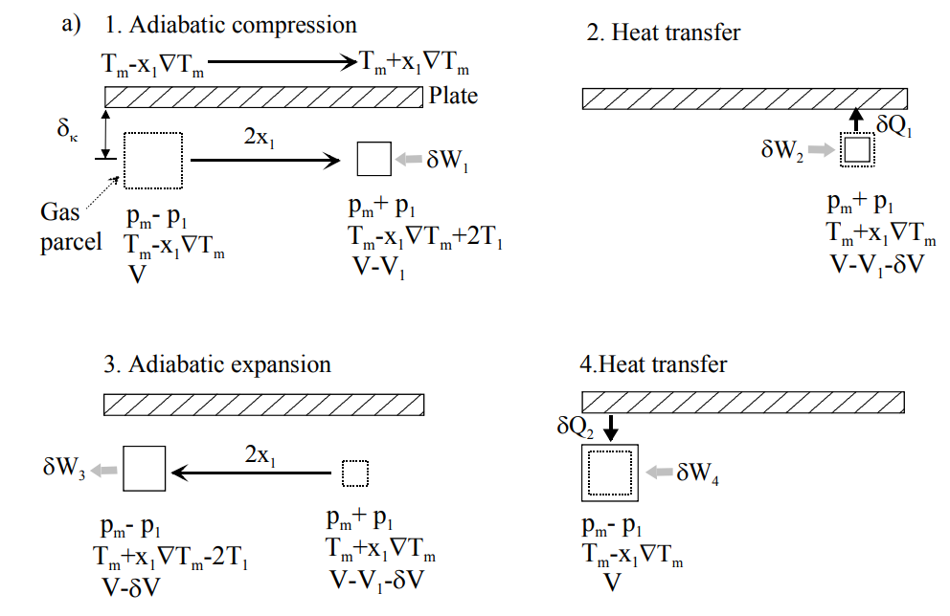

The Thermoacoustic Cycle
Equations of interest:
$δT=2T_{1}−2x_{1}∇T_{m}$ (1)
$∆T=\frac{T_{1}}{x_{1}}=\frac{p_{1}ω}{ρ_{m}c_{p}u_{1}}$ (2)
Figure 2.
Graphic showing the thermoacoustic cycle.
A gas parcel moves and is compressed adiabatically, leading to an increase in temperature.
Heat is transferred at constant pressure from the gas to the plate.
The parcel of gas moves back to its original position, leading to an expansion and cooling.
Since the gas is now colder than the stack, heat flows from the stack to the gas.
Notes:
To go into more detail, we will go over the thermoacoustic cycle. A graphic of this process is shown in the figure. The first step in this cycle is a gas parcel moving a distance 2$x_{1},$during which it is adiabatically compressed. This leads to the temperature increasing by 2$T_{1}.$ At this stage, the difference in temperature between the plate and the gas parcel can be described by equation 1 on the slide. The second term in this equation represents the temperature gradient along the stack. The next step in the cycle is a heat transfer. For positive $δT$ at constant pressure, heat flows from the gas parcel into the stack. Next, the parcel moves back to its original position in an adiabatic expansion and is cooled as a result. The final step of the cycle is another heat transfer. This time, the parcel is cooler than the stack, so the heat flows from the stack into the gas, allowing for the cycle to start over again.
If the two terms in equation 1 are equivalent, the temperature gradient in the stack becomes equation 2, where $p_{1}$ is the adiabatic pressure change, $c_{p}$ is the isobaric specific heat, $ρ_{m}$ is the density of the medium, $u_{1}$ is the velocity of the gas parcel, and $ω$ is the angular frequency.

Slide 4
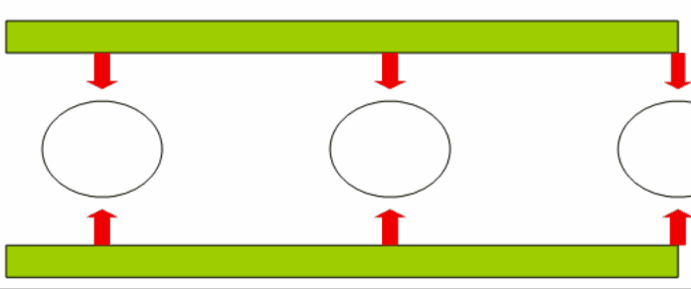
Thermoacoustic Cooling
Supplies: tube, stack, working fluid, driver
Tube: resonant standing wave with displacement and pressure nodes
displacement node = pressure antinode
For standing waves, the tube must be closed-closed or closed-open
Stack: allows air through but traps heat
Working fluid: medium for sound waves (air)
Driver: sound waves (speaker)
Heat transferred along stack via chain reaction
Each cycle increases temperature gradient
Figure 3.
Close-up graphic of heat transfer along one plate in the stack. Here, the chain-reaction is represented by “parcels” that interact with their immediate neighbors.
Notes:
We will focus our experiment and presentation on thermoacoustic cooling. In order to achieve thermoacoustic cooling, you need a resonant tube, a stack, a working fluid, and a driver. The resonant tube allows for a standing wave with displacement and pressure nodes. These nodes are separated by a distance of $π/2$, which means that the displacement node corresponds with the pressure antinode and vise-versa. For setups that use standing waves, the tube has to be closed on both ends or open on one end and closed on the other, a tube with two open ends would not produce these effects. Thermoacoustic cooling can also be observed with traveling waves, though the resonant tube would have to be a loop in order for it to work properly.
The stack is used so that air can pass through it, but the heat from compression is trapped at the displacement node, which is the end of the tube.
The working fluid is the medium in which the sound waves travel. Typical experiments use air at standard atmospheric pressure, which is what we will be doing.
The driver is needed in order to produce the sound waves and is often times a speaker.
Typical setups also include heat exchangers, but since we are not trying to outsource the cooling and are just trying to observe the temperature gradient, it is not needed in our setup.
With all of this, heat is transferred along the stack plates through a chain-reaction such that each successive wave pulse increases the heat gradient. The graphic on the side shows this process with the chain reaction being represented by individual “parcels” that interact with their immediate neighbors.

Slide 5
Motivation and goals
Motivated by curiosity
Connection between heat and sound
Goal: achieve the greatest possible temperature gradient
Effect of harmonic frequency and stack position
Notes:
Initially, the idea for thermoacoustic cooling was a suggestion from Dr. Sun. We had never encountered thermoacoustics in any of our classes, so we wanted to explore a new type of thermodynamic system. It is particularly interesting to us because it involves two seemingly unrelated phenomena: heat and sound. The experiment also seemed feasible and hands-on instead of relying heavily on machinery and special detectors, which appealed to us as well.
Our goal is to achieve and measure a temperature gradient in the tube along our stack. We will record how the different harmonic frequencies and stack positions affect the temperature gradient. For each harmonic, we will move the stack until the temperature difference is at a maximum. The overall goal is to achieve the greatest possible temperature difference for our materials.

Slide 6
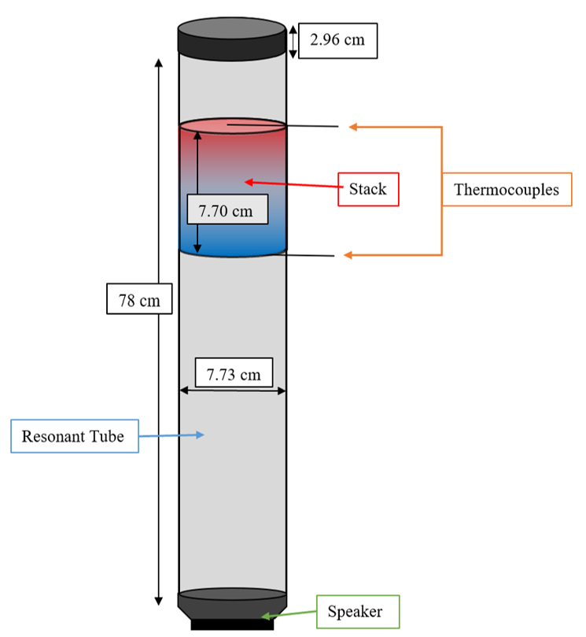

Outline of experiment
Fundamental frequency: $f_{1}=\frac{v_{sound}}{2L}$
Our tube: cardboard with both ends closed
$f_{1}=$219.87 Hz
3D printed stack with PETG 3D printer filament
Started with resin but was too fragile and failed during printing
PETG can withstand a higher temperature than PLA – up to 80 °C
Acquire and calibrate thermocouples
Top and bottom of stack
Obtain data
Temperature difference should be between 2ºC and 16ºC
Figure 4.
Schematic of our experimental setup. The red and blue regions of the stack indicate where we expect the hot and cold sides of the stack to be.​
Notes:
Our experimental setup starts with us choosing a tube with 1 closed end and 1 open end where the speaker will rest and create our sound to perform the experiment. We chose a cardboard tube and cut it to the length of about .78m. We now needed to calculate the fundamental frequency of this tube with the equation f1 equals velocity of sound divided by 2 times the length of the tube. The velocity of sound is 343m/s. This tells us that the fundamental frequency is about 219.87 Hz. The second step of our setup is getting the thermal stack that will hold our heat gradient for us to measure the temperature difference. We chose to 3D print our stack using PETG filament but this was after a few failures with resin and 3D printing difficulties. More on that later. We chose PETG because of its low thermal conductivity and high temperature tolerance of about 80 degrees Celsius. This means that it will be able to withstand the temperature difference that the setup will produces without deforming. We also needed to figure out the optimal stack geometry and positioning within the tube so that we get the best temperature difference. We used past research papers credited in our sources slide to figure this out. More on this later as well. The next step of our setup is to install thermocouples so we can measure the temperature difference between the top of the stack where the heat is captured because of air compression and the bot of the stack where it is cooler due to air expansion. We decided to use K-Type thermocouples with a double input thermometer because K-type thermocouples are the most accessible to us in the lab. We need to calibrate the thermocouple using items with known temperatures like boiling water or ice and then install them into the tube directly above and below the stack to measure temperature accurately. For our data collection, we will measure the temperature difference with different harmonic frequencies which are just integer multiples of our fundamental frequency. We want to know which harmonic gives us the best temperature difference. The expected value for the temperature difference is between 2 degrees Celsius and 16 degrees Celsius.

Slide 7
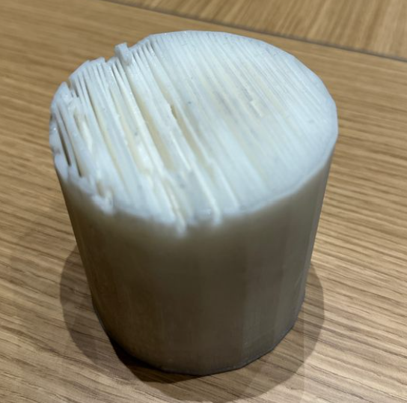
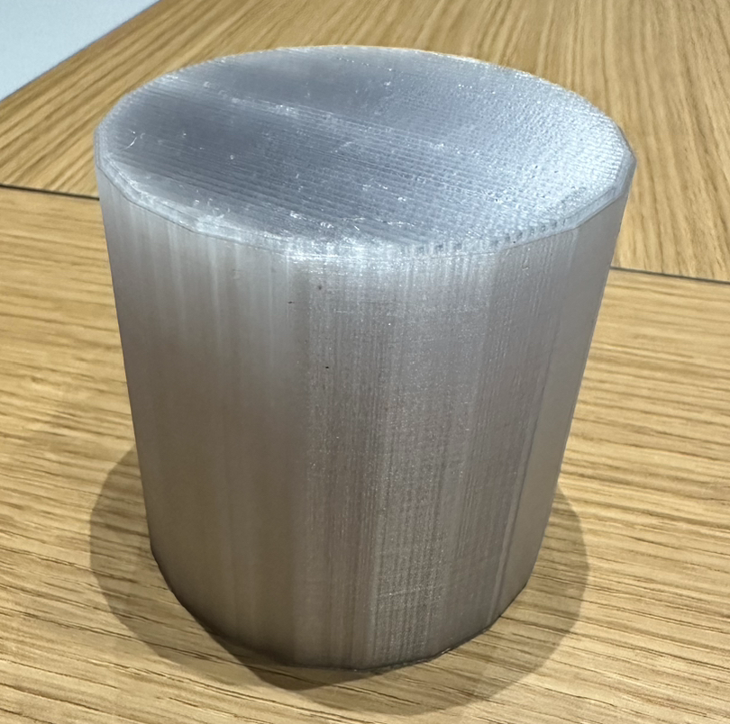
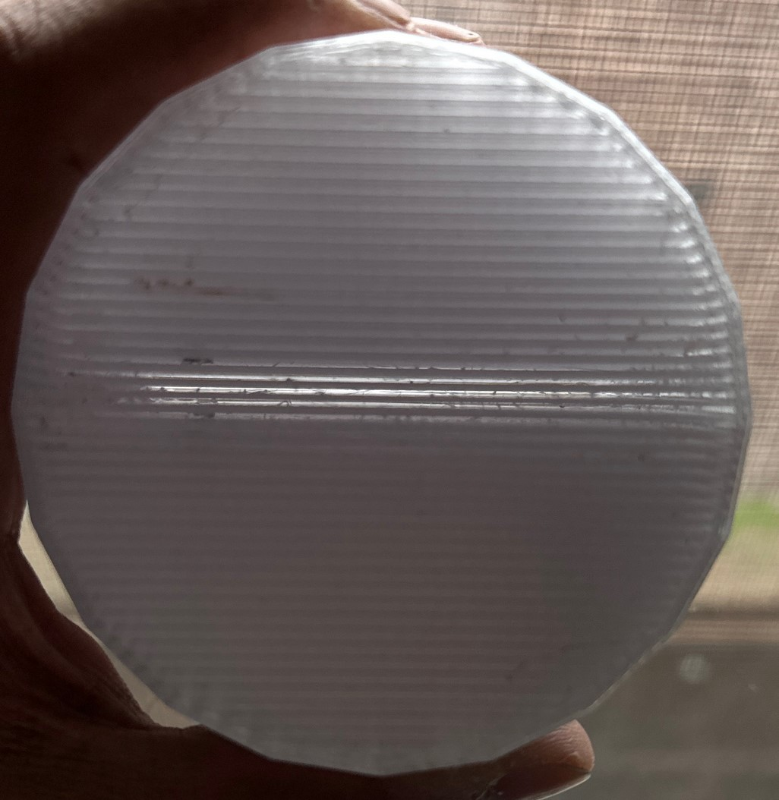
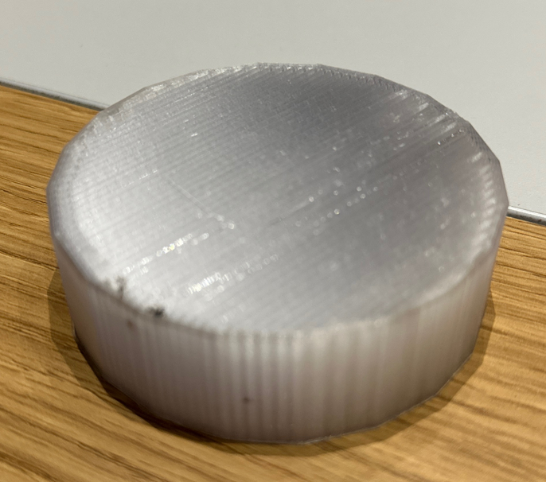
STACK ATTEMPTS
Second PETG print
Resin print failed
First PETG Print: printer error caused early stop
Still usable
Notes:
When we were building our stack we ran into a lot of trouble because of the complications involved with 3D printing. We first decided that it would be best to build our stack using Resin and the resin printers at the maker-space. We initially used resin because of its exceptional ability to withstand high temperature. But, unfortunately, resin is very weak for our stack to be hold up against the constant expansion and compression of air in the tube and the resing printer was causing a lot of error in the printing process. You can see the damaged print on the top left of this slide. So we decided to try the filament printing route. After talking to more experienced printers at the maker-space, we realized our best option is PETG filament because of its precision and it’s temperature tolerance. We started the print for PETG but our first print failed due to printer error. You can see the interrupted print on the bottom left of the slide. One of the officers at Maker-Space helped us restart the print and this time we were able to successfully print our stack. You can see the final finished print on the right of the slide. Because of recent issues involving restraints due to stack height, we have decided to use both the short filament stack and the tall filament stack and see which one works best.

Slide 8
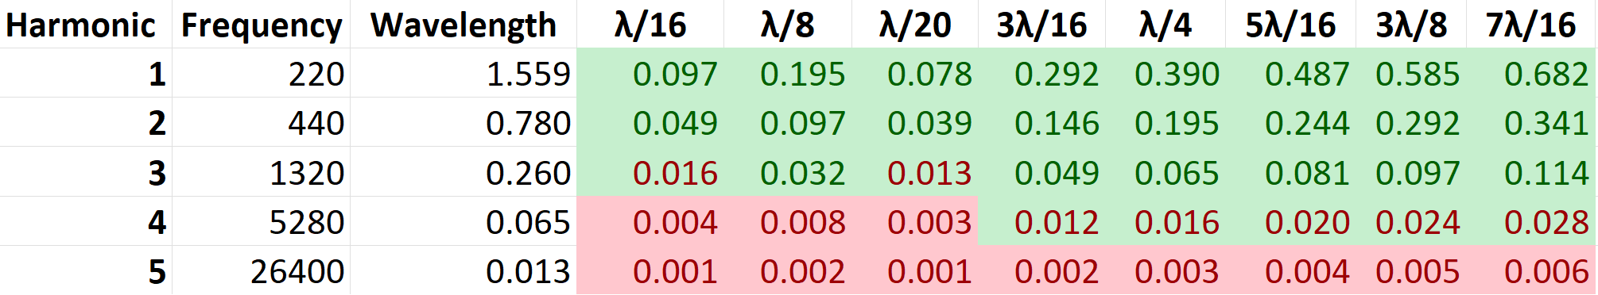

Stack position and Geometry
Stack Geometry: parallel plates
Thermal conductivity of filament: $κ$ $=$ 0.29 $\frac{J}{m∗K∗s}$
Density of air: $ρ$ $=$ 1.204 $\frac{Kg}{m^{3}}$
Specific heat of air: $c_{ρ}$ $=$ 1005 $\frac{J}{Kg ∗K}$
Angular fundamental frequency: $ω_{1}=2πf_{1}$ $=$ 1381.48 Hz
The distance between the plates is $x=2\sqrt{\frac{2κ}{ρC_{ρ}ω_{1}}}$ = 1.17 mm
Stack Position: between $λ/20$ and $λ/8$ from end of tube
Wavelength changes with harmonics: $λ_{n}=\frac{λ_{1}}{n}$
Stack position also changes
Figure 5.
Table of stack positions based on different harmonics. The green cells with green text indicate positions possible for both the larger and smaller stacks. Green cells with red text are only possible for the smaller stack. Red cells are not possible for either stack.
Notes:
Another important aspect of the stack is its geometry: what kind of openings it should have, how wide the openings should be and how tall it needs to be, and its position: where in the tube should the stack be for optimal temperature gradients. We did some research and found the the optimal stack geometry is parallel plates within the stack. The distance between the plates can be calculated using the thermal penetration depth equation as shown in the slides, and it needs to be about 10% of the tube length in height. The best stack position is between an eight of the wavelength of sound from the closed end of the tube to a twentieth of the wavelength of sound from the closed end of the tube. The issue with the position is that in our experiment, our harmonic frequency changes which also changes the wavelength of sound we use. So for every harmonic frequency we will need to readjust the stack position based on the wavelength for that harmonic. The table on the right shows you possible values of position from the closed end of the tube that our stack’s center can be placed at based on which harmonic we are using and how far we want to put it between an eight of the wavelength and a twentieth of the wavelength. Please read the caption to understand color-coding of values in the table. So, this adds a third component to our experiment which is how does the temperature difference depend on harmonic but for each harmonic how does the temperature difference depend on the stack positions.

Slide 9
Going forward…
By March 31: Calibrate the thermocouples
Boiling point of water and melting point of ice
By April 7: Choose and set up a speaker
Must play several harmonic frequencies
Must be powerful enough
April 10-14: Collect Data
Optimal stack position and harmonic
By April 28: Record video 2
Notes:
Our next step is to calibrate the thermocouples from the lab. Right now, the detector is severely uncalibrated and gives us readings over 3000 degrees Celsius. To calibrate the thermocouples, we will need to use the universally known temperatures of the boiling point of water and the melting point of ice. We will need to make sure that both thermocouples we are using are calibrated in the same way to the same temperatures, lest there be zero-point or scaling deviations in our measurements.
Next, we will need to select an appropriate speaker. We have set aside a few options in the lab, so we now need to test which ones produce loud enough sound in the range of our harmonic frequencies. We need to also find a proper power supply for the speaker, and we can use the power drawn in by the speaker and the resulting temperature difference to calculate the efficiency of our system. We may need to do some additional construction for the attachment of the speaker to the tube.
After that, all we have left is collecting data. As we mentioned, there are several options for harmonic frequencies and stack position, so we will test the different combinations to find which produces the greatest temperature difference. After that, we can determine if greater sound amplitude can produce a greater temperature difference. Once we have determined the optimal setup, we will record data points of temperature difference versus time since the sound was applied and find stabilizied equilibrium temperature difference of our system.

Slide 10
Sources
Aguirregabiria, Juan. Standing Waves in a Pipe Model. Vers. 1.0. Computer software. 2008. Java (JRE) 1.5. 16 Mar. 2023 <https://www.compadre.org/Repository/document/ServeFile.cfm?ID=7878&DocID=658>.
“Engineering Acoustics/Thermoacoustics - Wikibooks, Open Books for an Open World.” En.wikibooks.org, en.wikibooks.org/wiki/Engineering_Acoustics/Thermoacoustics. Accessed 19 Mar. 2023.​
Kajurek, J., Rusowicz, A., & Grzebielec, A. (2017). The influence of stack position and acoustic frequency on the performance of thermoacoustic refrigerator with the standing wave. Archives of Thermodynamics, 38(4), 89-107. doi:https://doi.org/10.1515/aoter-2017-0026
Kouta, Ahmad. “Understanding Thermoacoustic Engines & Refrigerators (CZ Subtitles).” www.youtube.com, 4 Feb. 2022, youtu.be/SRT02NcPD9U?t=286.​
“Mechanics -.” Princeton.edu, 2021, www.princeton.edu/~maelabs/hpt/mechanics/mecha_36.htm.​
PETG Technical Data Sheet (Polyethylene Terephthalate Copolyester). www.sd3d.com/wp-content/uploads/2017/06/MaterialTDS-PETG_01.pdf.​
Ramesh Nayak, B., Pundarika, G. & Arya, B. Influence of stack geometry on the performance of thermoacoustic refrigerator. Sādhanā 42, 223–230 (2017). https://doi.org/10.1007/s12046-016-0585-5
Tijani, M.E.H.. (2001). Loudspeaker-driven thermo-acoustic refrigeration. https://www.researchgate.net/publication/254810534_Loudspeaker-driven_thermo-acoustic_refrigeration.​
Urieli, Isreal. “Specific Heat Capacities of Air - (Updated 7/26/08).” Ohio.edu, 2019, www.ohio.edu/mechanical/thermo/property_tables/air/air_Cp_Cv.html.

